Slide 1
Climate Justice and Human Rights Petition in the Philippines
An investigation on the responsibility of 47 Fossil Fuel and Cement Companies for human rights violations or threats of violations resulting from the impacts of climate change
23 October 2019 |Bogor, Indonesia
Notes:
For an easy understanding of the Petition, here is a short animated video: https://www.facebook.com/greenpeaceph/videos/10155275810811400/

Slide 2
BRIEF DISCUSSION OF THE PETITION
Case No: CHR-NI-2016-0001
Title: Petition requesting for investigation of the responsibility of the Carbon Majors for human rights violations or threats of violations resulting from the impacts of climate change
Petitioners: Greenpeace Southeast Asia (Philippines) and 13 other non-profit organizations/civil society groups, 18 individuals [supported by Amnesty Int’l, BHRRC, UCS, ERI, CIEL, ITUC, Avaaz, CJP, WCELA, et al.]
Respondents: Chevron, ExxonMobil, Shell, BHP Billiton, and 43 other investor-owned coal, oil, gas, and cement transnational corporations
Notes:
-Alliance of youth organizations and students- Bicol

Slide 3
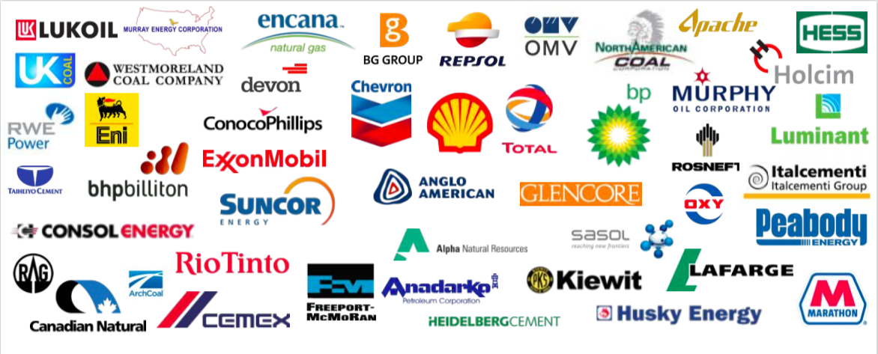
Notes:
Source: Greenpeace PPTX slides

Slide 4
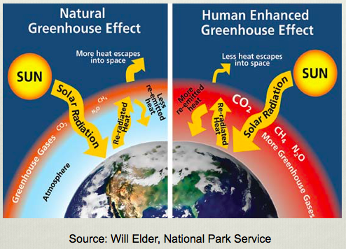
IN BRIEF
Notes:
Richard Heede’s Carbon Majors Study
Richard Heede’s Carbon Majors research, which is the basis of the Petition, indicates that the carbon dioxide and methane emissions linked to 50 investor-owned Carbon Majors, including all the respondents named in the Petition, contributed for roughly 16% of the global average temperature increase from 1880 to 2010, and around 11% of the global sea level rise during the same time frame; and from 1980 to 2010, a time period when fossil fuel companies were acutely aware that their products were causing global warming, these same companies contributed approximately 10% of the global average temperature increase and about 4% sea-level rise.
Update Heede’s work (October 9; The Guardian):
The twenty largest investor-owned and state-owned fossil fuel companies produced carbon fuels that emitted 35% of the global total (480 GtCO2e);
If we look over the entire historical data we find the current database of 103 fossil fuel and cement entities emitted 1,221 GtCO2e, or 69.8% of global since 1751 (1.75 TtCO2e); of which the Top Twenty companies are responsible for 526 GtCO2e, or 30% of all fossil fuel and cement emission since 1751;
These companies have significant moral, financial, and legal responsibility for the climate crisis, and a commensurate burden to help address the problem;
Half of all global fossil fuel and cement CO2 emissions since 1751 have been emitted since 1990;
The climate crisis is worsening, global emissions are still rising, and they must peak immediately in order to reduce emissions by 45% by 2030 and net zero by 2050

Slide 5
PETITIONERS’ POSITION
Climate science
Human rights harms being suffered by the petitioners and the Filipinos
Respondent Carbon Majors’ knowledge of foreseeable climate risks and harms to the people
Respondent Carbon Majors’ responsibility to respect human rights under international law and international agreements
Respondents’ moral and legal responsibility under the general principles of tort and human rights law
Notes:
Climate science
- The respondent Carbon Majors, together and individually, have extracted, marketed, and sold a substantial percentage of the fossil fuels burned globally, releasing an immense amount of carbon pollution into the Earth’s atmosphere, which is currently interfering with the climatic system.
There is a clear link between respondents’ climate pollution and global impacts, such as surface temperature and sea-level rise, which in turn is resulting in climate damage in the Philippines and human rights harms to Filipinos.
HR impacts
Climate change is already resulting in impairments, abuses, and violations of human rights across the Philippines. In the Joint Summary of the Amicus Curiae dated 19 March 2018, leading experts gave evidence to support this clear conclusion:
As the impacts of Typhoon Haiyan prove all too clearly, climate change is already resulting in adverse impacts to human lives and impairments of human rights across the Philippines. Through rising sea levels, changing hydrologic regimes and weather patterns, promotion of disease vectors, exacerbation of extreme weather events, and other climate impacts have caused and will continue to cause loss of life, injuries, property destruction, and human displacement, while also causing other gradual forms of environmental degradation that undermine and will continue to undermine access to clean water, food, education and other key resources. All of these climate impacts impair fundamental rights including the rights to life, health, clean water and sanitation, food, adequate housing, self-determination and development, and equality and non-discrimination. These effects will fall disproportionately on populations who are disadvantaged due to poverty, gender, age, disability, cultural, or ethnic background, and children and future generations who will experience increasingly severe impacts over time.
Respondent Carbon Majors’ knowledge of foreseeable climate risks and harms to people
Filipinos are dealing with a human rights crisis that the fossil fuel industry could have prevented. Many of the respondents have understood the significant risks posed to people by climate change and the role of fossil fuels in causing the problem for at least five decades.
By the 1980s, the entire fossil fuel industry knew there was a scientific consensus that climate change was real, caused by the use of their fossil fuel products, and would have significant impacts on the environment and human rights. Yet instead of acting on this information to reverse or limit the harmful impacts of their operations, there is evidence that certain companies used the information to support and maintain their harmful business model. With the establishment of the IPCC and the start of the global climate negotiations in the 1990s, the fossil fuel industry ran full blown campaigns to manufacture doubt about climate science, to delay meaningful action.
The respondents’ actions continue to demonstrate an intent to put profit over human rights, even today, despite the Paris Agreement entering into force and the IPCC’s Special Reports in 2018 and 2019. The respondents continued to invest in fossil fuel products, despite the clear scientific grounds for supporting a rapid phase-out to avoid the worst impacts of climate change. This is a new form of climate denial, where fossil fuel companies bet on humanity failing to achieve global and national climate commitments.
While a few of the respondents responded to the Petition with lofty statements about their efforts to address climate change, they have thus far refused to engage in a dialogue with the petitioners about the real climate harms being suffered by the Filipino people. Not one of the respondents submitted evidence or testified after the National Inquiry commenced, despite the CHR’s accommodating measures, such as conveniently holding inquiry hearings and consultations in countries where respondents are headquartered. The respondents’ disregard of the National Inquiry is yet another example of companies’ failure to fulfill their responsibility to act with due diligence and respect and protect human rights.
Respondent Carbon Majors’ responsibility to respect human rights under international law and agreements
Respondent Carbon Majors are acting unlawfully. They have a legal responsibility to respect, including through proactive measures, and protect the human rights of the Filipino people, as described in the United Nations Guiding Principles on Business and Human Rights (“UNGPs” for brevity) and international jurisprudence. The UNGPs should be interpreted in accordance with international environmental law and the international law governing climate change, including the precautionary principle and polluter pays principle, and with national laws and doctrines, like the Oposa Doctrine of “intergenerational responsibility.”
Under the UNGPs, business enterprises are required to commit at the highest level to respect human rights, undertake human rights due diligence to identify and avoid potential adverse impacts and provide remedy in the event of adverse harm.
More specifically for the respondent Carbon Majors, the responsibility to respect and protect human rights entails an obligation on the part of the respondents not to contribute to human rights impacts, impairments, infringements, abuses, and/or violations arising from climate change; as well as prevent, mitigate, and accept responsibility for the adverse human rights impacts linked to their activities, as directed by the Interpretive Guidance of the UNGPs.
As explained in the Joint Summary of the Amicus Curiae, “[t]he Interpretive Guidance confirms that an enterprise can contribute to an adverse human rights impact through the legal sale of its products. The evidence demonstrates that the respondents have, through their operations and products, caused the emissions of greenhouse gases in such significant quantities as to have contributed to climate change, to impose on them specific and particular obligations in respect of the human rights impacts of climate change.”
Respondents’ moral and legal responsibility under general principles of tort and human rights law
Finally, under fundamental principles of responsibility that are common to judicial systems around the world, respondents will ultimately be held legally responsible for the harms being suffered by communities. The fossil fuel companies had early awareness, notice, and actual knowledge of the role of coal, oil, and gas products in causing climate change and the reasonably foreseeable human rights harms resulting from climate impacts.
Significantly, fossil fuel companies had the opportunity to avoid or reduce those harms. However, their past and current activities -- including the extraction, marketing, and sale of fossil fuels and past and current efforts to undermine climate science and solutions -- have and continue to materially contribute to the climate damage resulting in human rights harms to petitioners and Filipinos, in general.

Slide 6
IN A NUTSHELL
The fossil fuel industry has a moral and legal obligation to prevent business activities from harming people and communities. The companies have responsibility to respect human rights. And this is not optional. It arises from a global standard of expected conduct.
The industry knew about climate change half a century ago, yet continues to mine, drill and burn fossil fuels while those most vulnerable face the ever-increasing devastating impacts of climate change. But these communities have had enough and are rising up and reaching for a better future by challenging fossil fuels.
The petitioners are part of a flourishing climate justice movement who are taking legal action to reclaim their lives and livelihoods and fighting on behalf of all of us for the right to a stable climate and healthy environment.

Slide 7
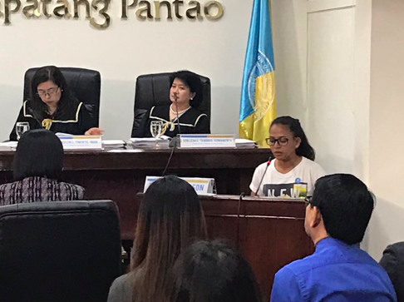
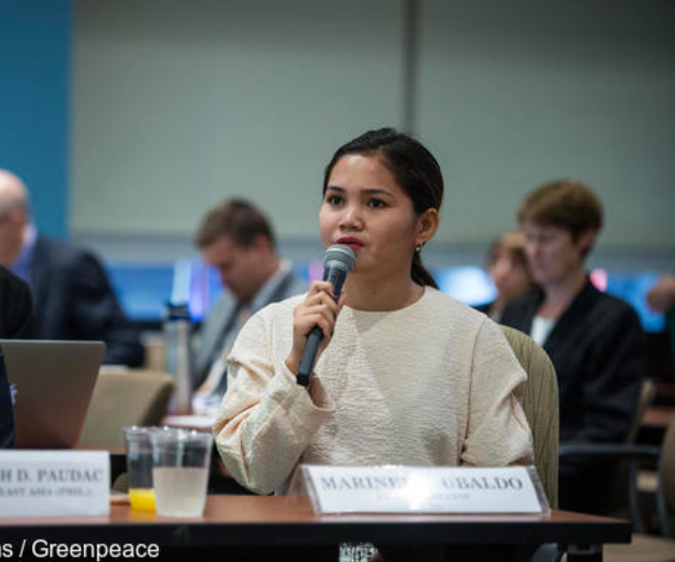
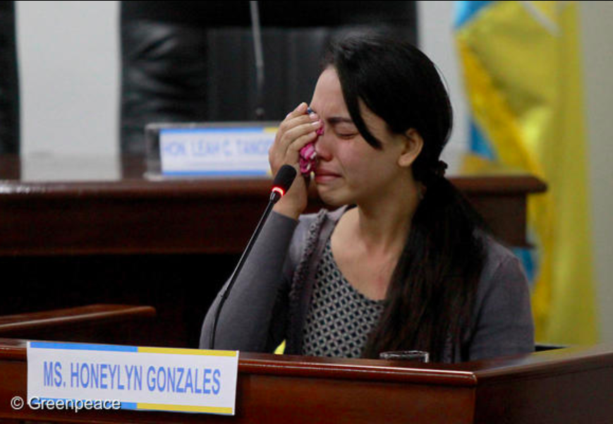
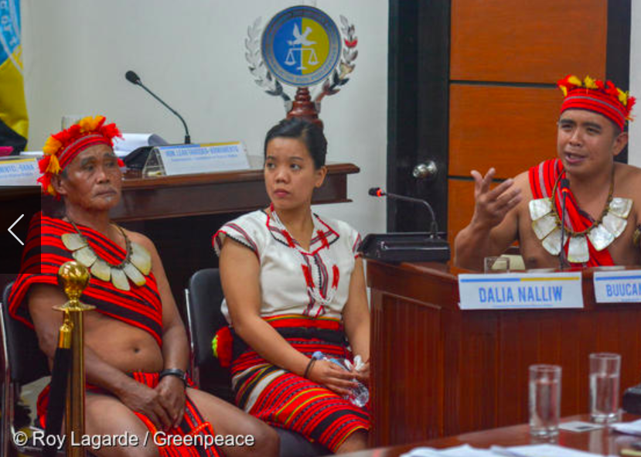
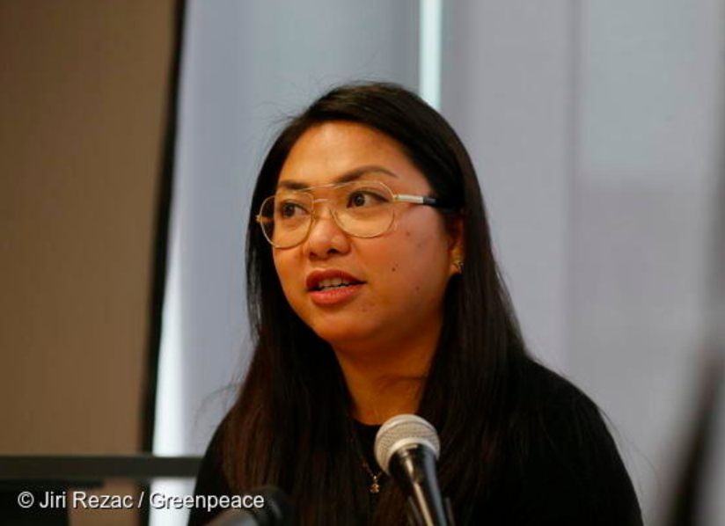
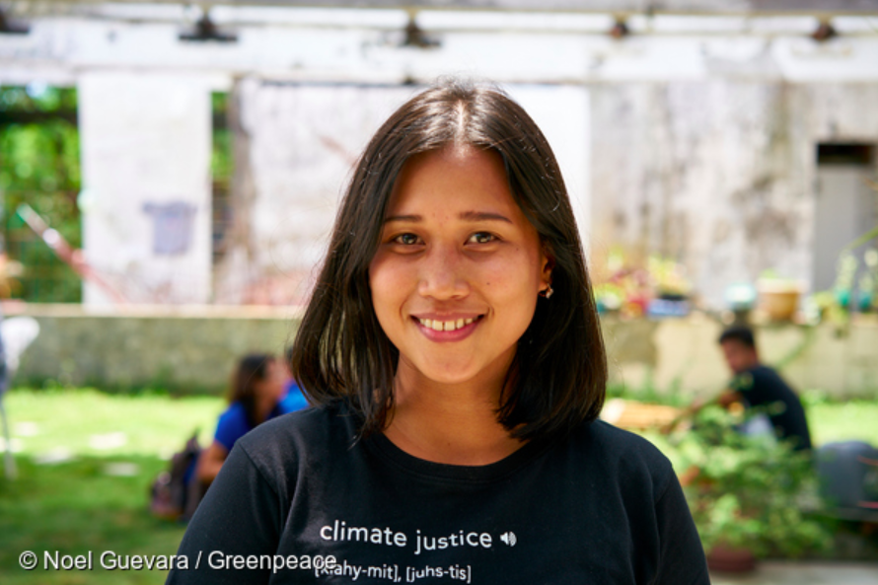

Slide 8
RELIEFS
Issue a finding of responsibility.
Recommend to policy makers to develop and adopt implementable standard for corporate reporting of human rights issues in CC context.
Further recommend effective accountability mechanism accessible by HR victims in the context of climate change.
Request Carbon Majors to submit plans on how to eliminate, remedy and prevent HR infringements in the context of CC.
Recommend that governments in the Philippines and other countries where Carbon Majors are domiciled fulfill the international duty of cooperation and ensure the Carbon Majors take steps to address the human rights implications of climate change.
Monitor people especially vulnerable communities to the impacts of climate change.
Notes:
Recommendations
Issue a finding on the responsibility of the respondent Carbon Majors for human rights impacts, impairments, infringements, abuses, and/or violations resulting from the effects of climate change in the Philippines;
Host an official online repository of this National Inquiry’s full record that is searchable and accessible to all;
Monitor people and communities in the Philippines made vulnerable to the impacts of climate change on an ongoing basis;
Request the respondent Carbon Majors to submit business plans regarding climate change that are consistent with both international and national human rights laws and requirements;
Monitor respondent Carbon Majors on an ongoing basis and report periodically on whether respondents’ actions are consistent with both international and national human rights laws and requirements;
Recommend that policymakers and legislators develop and adopt clear and implementable objective standards for corporate reporting on human rights in the context of climate change;
Recommend the adoption of one or more accountability mechanisms that provide an effective remedy that can be easily accessed by those affected by climate change;
Recommend that the government develop a National Action Plan on business, environment, and climate change, using as a starting point the United Nations Guiding Principles on Business and Human Rights and relevant pieces of evidence herein presented; and
Recommend that governments -- including the Philippines and other countries where the respondent Carbon Majors are domiciled and/or operate -- enhance, strengthen, or explore new ways to fulfill their international duty of cooperation, including but not limited to, the introduction of further regulation of the Carbon Majors to fully address the human rights impacts of climate change.

Slide 9
SUMMARY OF PLEADINGS/DOCUMENTS
Pleadings/Communications from Respondents and Amicus Curiae Submissions | Number
Responses/Answers or respondents’ engagement to some degree to the Petition | 21
Rejoinders | 7
Amicus Curiae Briefs | 14
Notes:
On various dates, the CHR received seventeen (19) responses out of the forty-seven (47) respondents summoned, while petitioners received fourteen (14) responses, two (2) of which came from Repsol. Meanwhile, the Business and Human Rights Resource Centre (“BHRRC”) received eleven (11) responses.
To aid the CHR in its important task to understand key issues relating to its authority to investigate and the responsibility of the respondents for climate-related human rights harms, fourteen (14) distinguished key resource persons and international organizations willingly submitted their respective amicus curiae briefs (i.e., Environmental Law Alliance Worldwide; ClientEarth; Mary Robinson Foundation – Climate Justice; Our Children’s Trust; joint submission from Olivier De Schutter, Asbjørn Eide, Ashfaq Khalfan, Rolf Künnemann, Jernej Letnar Černič, Marcos A. Orellana, Ian Seiderman, and Bret Thiele; Plan B, through Timothy Crosland; Sabin Center for Climate Change Law, Columbia Law School; Professor Sara Seck; Kevin E. Trenberth; Asia Pacific Forum of National Human Rights Institutions [AFP] and Global Alliance of National Human Rights Institutions [GANHRI]; UNICEF-Philippines; James Hansen; and Center for International Environmental Law [CIEL]).

Slide 10
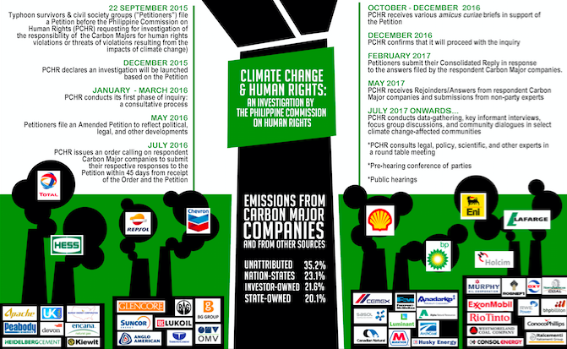
SUMMARY OF CHR PROCEEDINGS (Timeline: 2015-2017)

Slide 11
SUMMARY OF PUBLIC HEARINGS (Timeline: March 2018 – December 2018)
Notes:
CHR consultation per se did not push through. But the CHR participated in 2 events in January 16 and 18. January 16 was a half day event by the petitioners on the topic, “Corporate action on human rights and climate change: a deep dive into Shell's actions and policies” and another event hosted by Nyenrode Business University on January 18 entitled, “Climate Responsibilities of Business.”

Slide 12
OVERVIEW OF THE PUBLIC HEARINGS/INQUIRY
NUMBER OF HEARINGS
12 in total (March to December);
2 hearings per month
NUMBER OF WITNESSES
78 in total
26 Community Witnesses;
39 Expert Resource Persons (Petitioners)
13 Expert Resource Persons (CHR)
NUMBER OF EXHIBITS
239 in total
19 (December 2017); 32 (March 2018); 44 (May 2018); 49 (August 2018); 25 (September 2018); 43 (November 2018); 27 (December 2018)

Slide 13
WHERE WE ARE RIGHT NOW
Petitioners filed their Memorandum on 19 September 2019
The CHR is expected to come out with a Resolution end of this year (at the latest during COP25 in Chile)

Slide 14
INSIGHTS
Lessons Learned & Opportunities
Strategies
Challenges
Notes:
CHALLENGES
The CHR as a venue (First time they’ll handle a case like this; No technical expertise when it comes to the issue of climate change; Budgetary concerns to hold inquiry hearings; Not a priority issue [Other more popular issues like war on drugs, etc.])
No legal precedents to cite as the issue is novel (interlink of climate change and human rights)
Political (President’s current pronouncements regarding the issue on climate change; not allowing his cabinet officials to go to conferences abroad on the topic)
Climate change as a “foreign” concept to Filipinos (not one of the key issues being discussed nationally)
STRATEGIES
- Diverse witnesses/resource persons to triangulate the data (Community witnesses from all over the country and overseas, local experts, international experts in relevant fields)
Putting pressure to the CHR by making sure that they commit to the timeline that they’ve set and publicly announced (creating international spaces to amplify the case; elevating the CHR’s profile)
Strategic alliances with like-minded groups and individuals (community reach out)
Legal, political, and campaign missions (LGUs support)
International support of respected groups
LESSONS LEARNED
It can be done. No such thing as David v. Goliath if you are fighting for a good cause. And there’s no better cause than the cause for the environment and human rights. You can’t advocate for HR without learning the basic right to life, that is, to live a good life. One of the rudiments of living a good life is having a stable climate and healthful and balanced ecology.
This is a movement, you don’t have to work alone. Maintain links to allies and create new opportunities to network because they will provide good resources when needed. Together, we can do it better. In silo, we will wander in oblivion.
Ownership of the whole process (petitioners and lawyers; the Commission; and the stakeholders/networks) – 4 year journey
OPPORTUNITIES
Replicated – Who to file; what; against whom; depends on the laws of the country

Slide 15
Relevant Links
All documents relating to the National Inquiry:
https://www.greenpeace.org/philippines/press/1237/the-climate-change-and-human-rights-petition/
Joint Summary of the Amicus Curiae Briefs to the Philippine Commission on Human Rights: http://www.ciel.org/reports/philippines-joint-amicus/
Environmental Science for Social Change’s Portal on National Inquiry on Climate Change: http://essc.org.ph/content/nicc/
Official Transcript of Stenographic Notes of the National Inquiry:
http://chr.gov.ph/nicc-resources/

