Slide 1
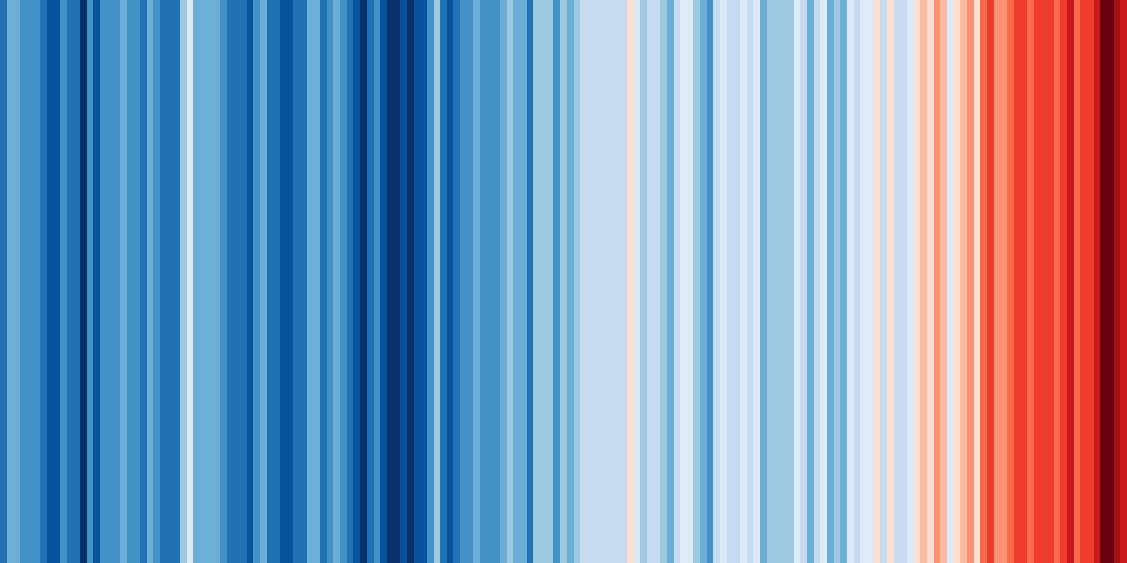
Rights of the Child to a Healthy & Sustainable Environment
UNICEF | KWM
22 October 2019

Slide 2
Why Children?
More vulnerable to diseases and illnesses due to under-developed immune systems
Physiologically developing and hence face more dangers both physically and cognitively to extreme weather and environmental factors
They face greater dangers from undernutrition
and diarrhoeal diseases
Socially and economically dependent on adults
Not just victims but can also be agents of change in their communities
Will bear the brunt of climate change far longer than adults
Poor children are especially vulnerable
Convention on the Rights of the Child
Articles on survival and development, health (including considering environmental pollution risks), adequate standard of living, education
Notes:
Why children specifically?
The CRC:
Climate change threatens children’s survival, development, nutrition, education, and access to health care – all of which are children’s rights and shrined in the Convention on the Rights of the Child. Articles 6 (Survival and development), 24 (Health and health services), 27 (Adequate standard of living), 28(Right to education) and 29 (Goals of education) all make some reference to it. In addition, Article 24 of the CRC makes explicit mention of considering “the dangers and risks of environmental pollution”.
Children are the most vulnerable to climate impacts:
Physiologically developing and hence face more dangers both physically and mentally to extreme weather
Often socially and economically dependent on adults
Will bear the brunt of climate change far longer than adults, given their younger age and number of years ahead of them.
They face greater dangers from undernutrition and diarrhoeal diseases – with diarrhoeal diseases being one of the highest causes of child mortality in the region
More vulnerable to vector-borne diseases due to under-developed immune systems
Poverty plays a crucial threat multiplier and hence, poor children are even more vulnerable, given their lack of resources and capacity to adapt/ mitigate risks
However, important to note that children are not just victims, this narrative is all too common. In many communities, they have started becoming agents of change as well and we have to promote that. For eg. A study by Plan International suggests that children are often more knowledgeable about climate change impacts than adults, based on information learned at school or from accessing environmental resources through other media and communication resources.
Given their vulnerability and their great potential to contribute to addressing climate change as change agents, as adults, we need to take action in both protecting them and developing them to face the challenges of tomorrow. In the following slides, I will cover the main impacts from climate and environmental degradation on children, and not just limited to health but in sectors beyond it which UNICEF is actively engaged in.

Slide 3
Climate Change Impacts on Children
Floods and Severe Storms
Droughts and Water Stress
Heat Stress
Diseases

Slide 4
Environmental Impacts on Children
Air Pollution
Waste
Pesticides
Deforestation

Slide 5
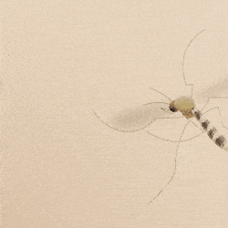
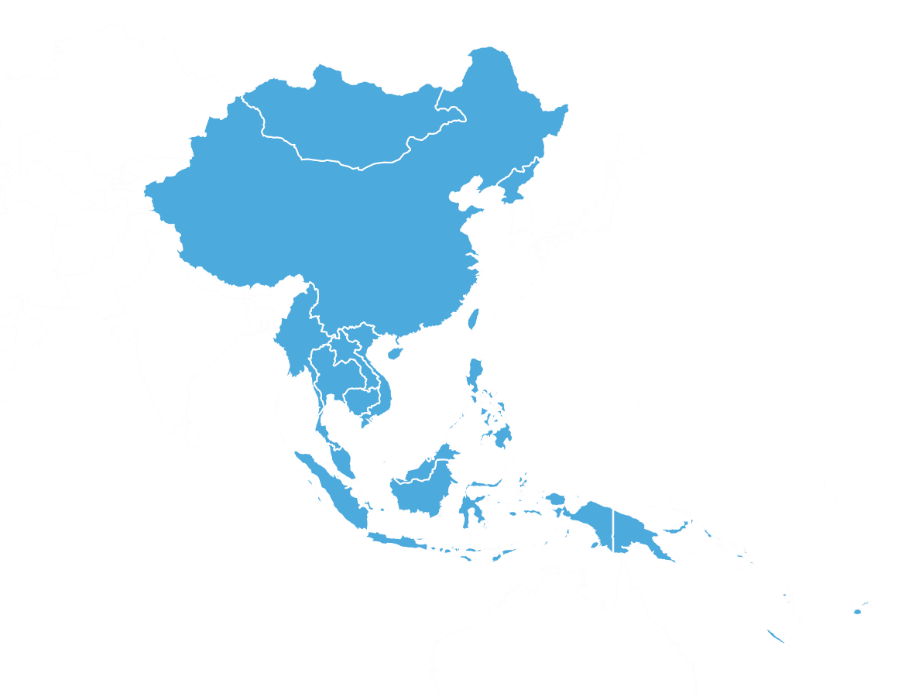
What Are The Main Climate Risks for our Region?
Morbidity and mortality from climate-sensitive diseases
Temperature rise of about 0.5–2°C by 2030 and
1–7°C by 2070
Sea Level Rise, 10-20% > global mean by 2100
Saltwater intrusion
Flooding
Crop yields, from 5-30% by 2050 relative to 1990 levels with risks of hunger
10% of rainfall by 2050, seriously compromising freshwater resources
Significant loss of coral reefs and mangroves, with knock-on effects on commercial fishing and artisanal fisheries
Source: IPCC AR4 and AR5

Slide 6
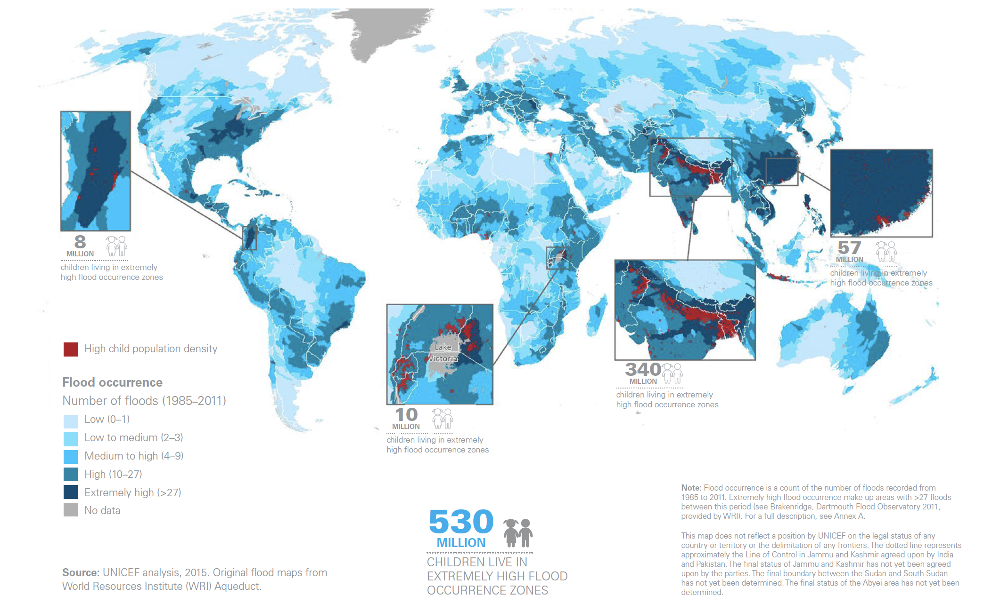
Floods and Severe Storms
More than half a billion children live in extremely high flood occurrence zones, the vast majority of them live in Asia
Floods threaten children’s survival and development. Direct impacts include injuries and death by drowning
Indirectly, floods pose a grave risk to children’s health. Floods compromise safe water supplies, increasing the risk of diarrhoea outbreaks. They also damage sanitation facilities, contributing to water contamination and undermining the sustainability of sanitation behaviours

Slide 7
East Asia Pacific - 1/3 of Global CO2 emissions

Slide 8
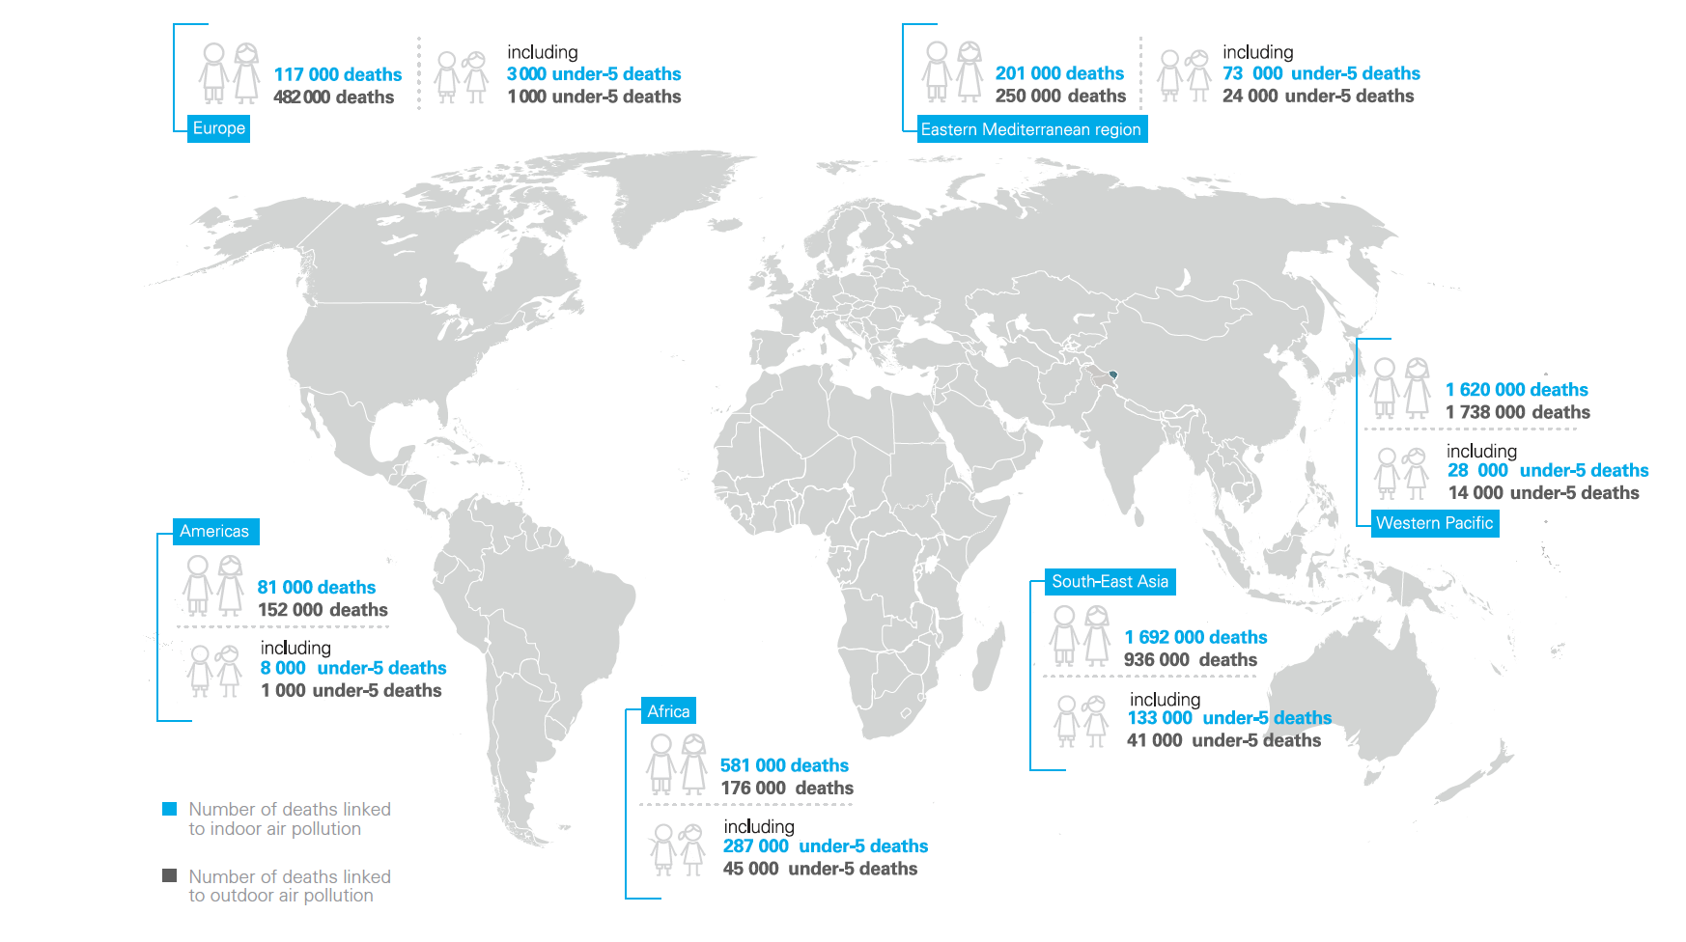
Air Pollution
Nearly 1 in 10 under-5 deaths is linked to air pollution
In South-east Asia and Western Pacific, more than 150,000 and 55,000 under-5 deaths due to indoor and outdoor air pollution respectively in 2012
Leading risk factor for child deaths in many countries
Globally, 7 million deaths are attributed to air pollution in 2016
Source: WHO 2012, UNICEF 2016

Slide 9
Country | Climate Risk Index Rank | Fatalities/ annual average | Fatalities per 100,000 | Losses in US$ Millions (Annual Average) | Losses per unit GDP
Myanmar | 3 | 7 048.850 | 14.392 | 1 275.961 | 0.661
Philippines | 5 | 867.400 | 0.971 | 2 932.153 | 0.576
Viet Nam | 9 | 296.400 | 0.350 | 2 064.740 | 0.516
Thailand | 13 | 137.800 | 0.209 | 7 894.763 | 0.936
Cambodia | 19 | 53.300 | 0.384 | 242.493 | 0.723
Fiji | 20 | 7 | 0.837 | 119.983 | 1.896
China | 37 | 1 240.800 | 0.094 | 36 601.070 | 0.288
Mongolia | 62 | 6.900 | 0.259 | 82.338 | 0.307
Indonesia | 69 | 252.000 | 0.109 | 1 798.562 | 0.083
Lao PDR | 89 | 6.300 | 0.108 | 73.910 | 0.237
Papua New Guinea | 95 | 18.250 | 0.285 | 15.065 | 0.076
Malaysia | 116 | 21.450 | 0.078 | 182.228 | 0.033
Timor-Leste | 177 | 0.100 | 0.010 | 0.266 | 0.004
Global Climate Risk Index 2019 (for 1998-2017 period)

Slide 10
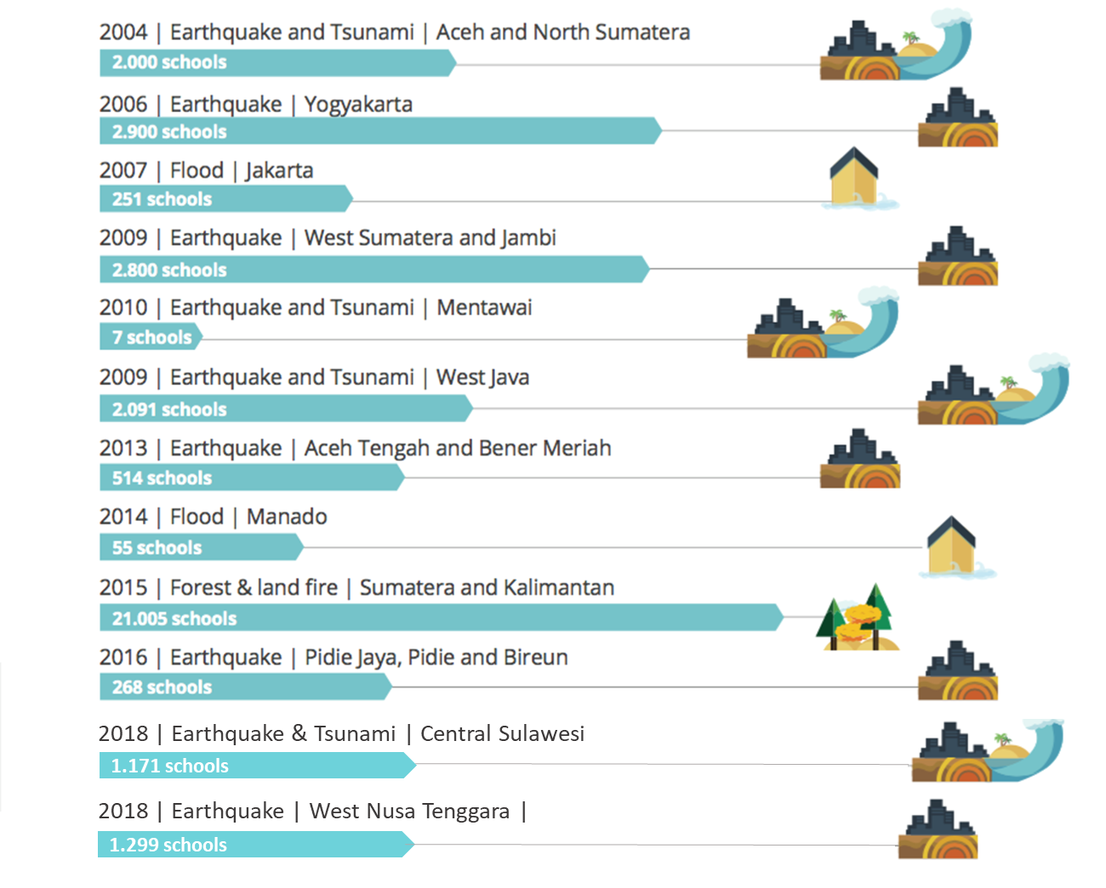
Impact on education – Indonesia example
Over past 15 years
49,118 schools affected by disasters

Slide 11
UNICEF’s Focus Areas
REDUCE EMISSIONS AND POLLUTION
MAKE CHILDREN THE FOCUS OF ENVIRONMENTAL STRATEGIES
PROTECT CHILDREN FROM IMPACTS
EMPOWER CHILDREN TO BE AGENTS OF CHANGE

Slide 12
Examples of a Results Framework of the UNICEF East Asia Regional
Climate Change Action Plan 2020-2023 (to be updated 2022)
Output | Output Indicators
Outcome 1: Climate resilience of children, especially, most vulnerable children is enhanced through child-sensitive climate resilient solutions packages
1.1. Climate resilient WASH | # of countries with climate risk management plans for WASH # of communities with climate resilient water supply systems in # of countries # of children with improved drinking water services in # of drought-prone areas in # of countries
1.2. Climate resilient Health | # of countries with climate vulnerability assessments for child health # of countries tracking children’s environmental health # of local health centers with climate risk assessments and measures # of children benefiting from enhanced vector control measures in # climate hotspots for vector-borne diseases
1.3. Climate resilient Education | # of countries with climate vulnerability assessment for education, integrating climate data into EMIS and education planning and budgeting # of schools with climate adaptation and eco-school initiatives # of children benefiting from alternative climate resilient learning modalities in # climate hotspot countries
1.4. Climate resilient Nutrition | # of countries with nutrition-sensitive climate mitigation and adaptation plans # of children receiving climate smart nutrition services
1.5. Adaptive Social Protection | # of countries with adaptive social protection schemes, child poverty analysis # of children receiving social protection support that explicitly addresses climate adaptation needs

Slide 13
Examples of a Results Framework of the UNICEF East Asia Regional
Climate Change Action Plan 2020-2023 (to be updated 2022)
Output | Output Indicators
Outcome 2: Greenhouse gas emissions are limited through child-sensitive climate smart solutions
2.1. Decentralized clean energy services | # of children benefiting from schools with improved access to clean, affordable and reliable modern energy # of children benefiting from health care centers with access to clean, affordable and reliable modern energy # of communities with clean and affordable technologies and fuel for cooking and heating
2.2. Clean air solutions | # of urban areas with child-sensitive air quality monitoring systems # of urban areas with child-sensitive clean air plans # of children participating in air quality monitoring # of children participating in clean air solutions
Outcome 3: Children’s needs and perspectives are integrated into national policies and investments related to climate change
3.1. Child-sensitive climate change policies and plans | # of countries and local governments with child-sensitive climate change policies and plans
3.2. Public finance for child-sensitive climate change | # of countries with tracking climate change budget for children # of countries and local governments with budget allocation for child-sensitive climate actions
3.3. Youth participation mechanisms | # of children and youth groups participating in climate change policy making and investment decision-making # of children and youth groups participating in design and implementation of climate solutions

Slide 14
Laws relating to child rights
King & Wood Mallesons / www.kwm.com
Notes:
There has been an increase in laws enacted relating to child rights and the environment over the last 3 decades in the region.
150 laws have been passed in the 5 countries reviewed since 1989 (Fiji, Mongolia, Cambodia, Vietnam, Indonesia)

Slide 15
Laws since 1989
King & Wood Mallesons / www.kwm.com
Notes:
The number of laws being passed relating to child rights and the environment are increasing each year.
There have been some sharp increases in laws during periods of legislative reform. This may be owing to technical and financial inputs from development partners or a change in government (e.g. Mongolia’s reform of its environmental laws in 2012)
There seems to be some correlation between the enactment of international treaties relevant to children’s rights and environmental protection and an increase in domestic laws (although these laws do not necessarily relate specifically to those treaties)
There also seems to be a significant lag between these international laws entering into force and their enactment into domestic law
The low point in the graph coincides with the Global Financial Crisis – potentially indicating the connection between economic concerns and environmental concerns and the fact that environmental concerns become less immediate in times of economic recession

Slide 16
Overview of Existing Laws in Five Countries
King & Wood Mallesons / www.kwm.com

Slide 17
Overview of Existing Laws in Five Countries
King & Wood Mallesons / www.kwm.com

Slide 18
Recommendations
Effective implementation and enforcement of laws
Raise government, business and public awareness
Require businesses to comply with human rights principles
Collaboration between countries on a follow-up project on guiding principles
Integrate child’s rights into existing environmental impact assessments
Collaboration between neighbouring states in preventing transboundary harms
Implement existing special rapporteur report recommendations
Encourage a multi-sectoral approach from human rights bodies
King & Wood Mallesons / www.kwm.com
Notes:
8 recommendations:
Where laws have been made on children’s environmental rights, they need to be able to be effectively implemented and enforced. This would involve countries passing any subsidiary legislation or regulations as necessary.
The public needs to be made more aware of environmental rights and the connection between children’s rights and the environment.
There should be laws in place which require businesses to comply with principles relating to business and human rights, such as:
the Guiding Principles on Business and Human Rights (2011)
the Children’s Rights and Business Principles (2012)
The recommendations of the Committee on the Rights of the Child in its general comment No. 16 (2013)
Countries should collaborate on a joint follow up project to develop guiding principles on children’s environmental rights in the region, with the aim of ensuring consistent implementation and enforcement of children’s rights to a healthy and safe environment.
Countries should incorporate specific considerations of children’s rights and environmental and social safeguards into their existing environmental impact assessments required for infrastructure, mineral and urban planning projects. Local officials must also be informed about the children’s right to a healthy and safe environment and have the sufficient resources and capacity to implement environmental legislation effectively.
Countries in the region should collaborate with neighbouring countries to share best practice and create responses to transboundary harms
Global reports into the environment, children’s rights and human rights should be implemented, such as:
The SR HRE (2018) and
The Special Rapporteur on Extreme Poverty and Human Rights (2019)
And any other country-specific reports
Human rights bodies across multiple sectors (such as human rights commissions, NGOs, government departments, IGOs and other stakeholders) should work together to focus on, and raise awareness of, national environmental and children’s rights.

Slide 19
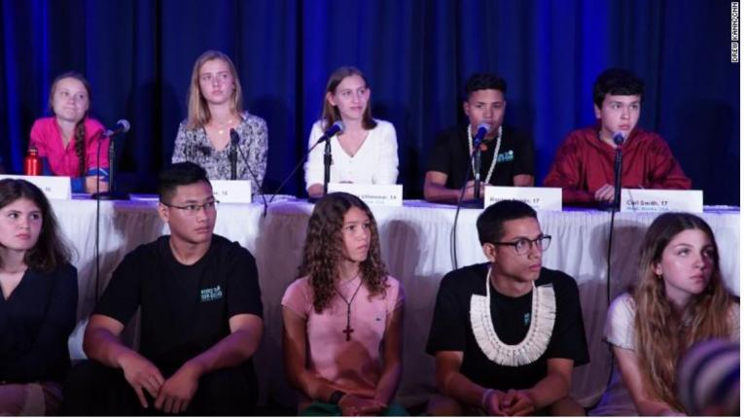
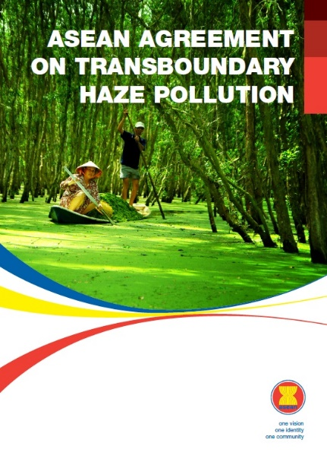
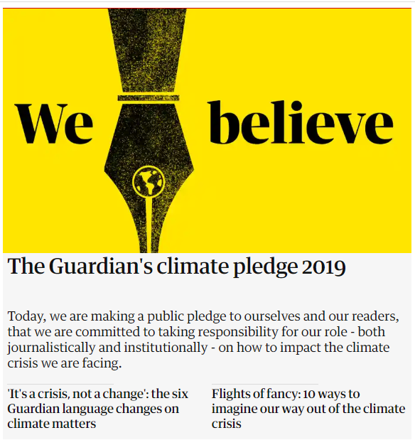
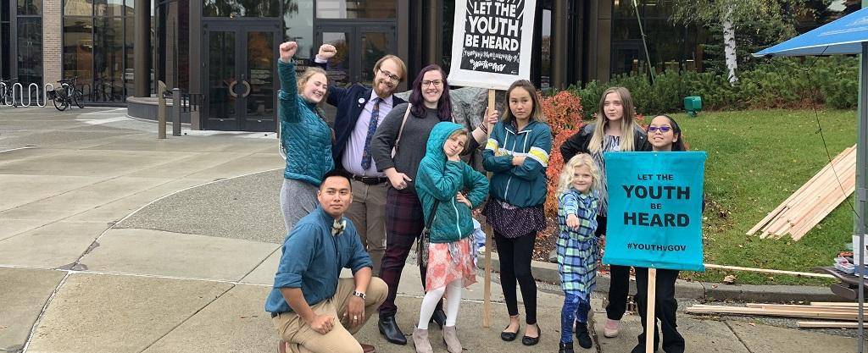
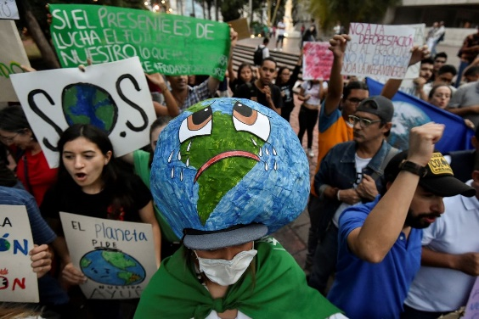
Examples of what this looks like in practice

Slide 20
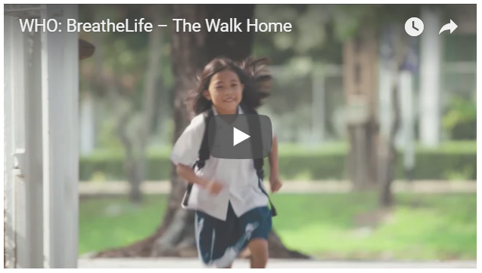
Thank you

